Slide 1
Project
Introduction and Linux Hardening
Cybersecurity
Lesson 10.1

Slide 3
Hardening your Linux Server

Slide 4

Recap
Throughout this course, you’ve learned:
1
Terminal
2
Systems administration
3
Networking

Slide 5
Project 1 Overview
Project week will run a little differently. Each day will proceed with:
01
A brief lecture introducing new concepts.
02
A brief overview of project tasks.
03
A provided guide to help you work on completing your tasks.

Slide 6
⚠️ Important ⚠️
Everyone will submit their own project. You can choose to work independently or in groups, but are required to remain in class.
Each day's lesson builds on the previous day, so all activities are required to be completed in order.

Slide 7
Daily Objectives and Milestones
Day 1
Day 2
Day 3
Harden an organization's linux server's users, groups, files, and directories.
Configure the SSH settings, system packages, services, and logging configurations.
Automate and schedule tasks from Day 1 and
Day 2.
Notes:
#3 Instructor Do
The term digital marketing wasn’t even used before the 1990s (source). Personal computers started becoming popular in the 1980s, but the advent of the internet in the 1990s is what pivoted the direction of marketing. Even into the early 2000s, marketers largely relied on traditional channels to promote their wares.

Slide 8

Project Deliverables
As you work through the project, you will develop the following deliverables:
Completed script
Checklist and project summary

Slide 9

Learning Objectives
Today’s lesson will cover:
1
Introduction to Linux hardening.
2
Overview of tasks to complete on Day 1.
3
Project work.

Slide 10

Hardening Your Linux Server

Slide 11
We have had several units that
have illustrated how Linux operating systems function and the benefits they can provide.

Slide 12
Hardening is a process a security or IT professional can take to minimize their security risks.

Slide 13
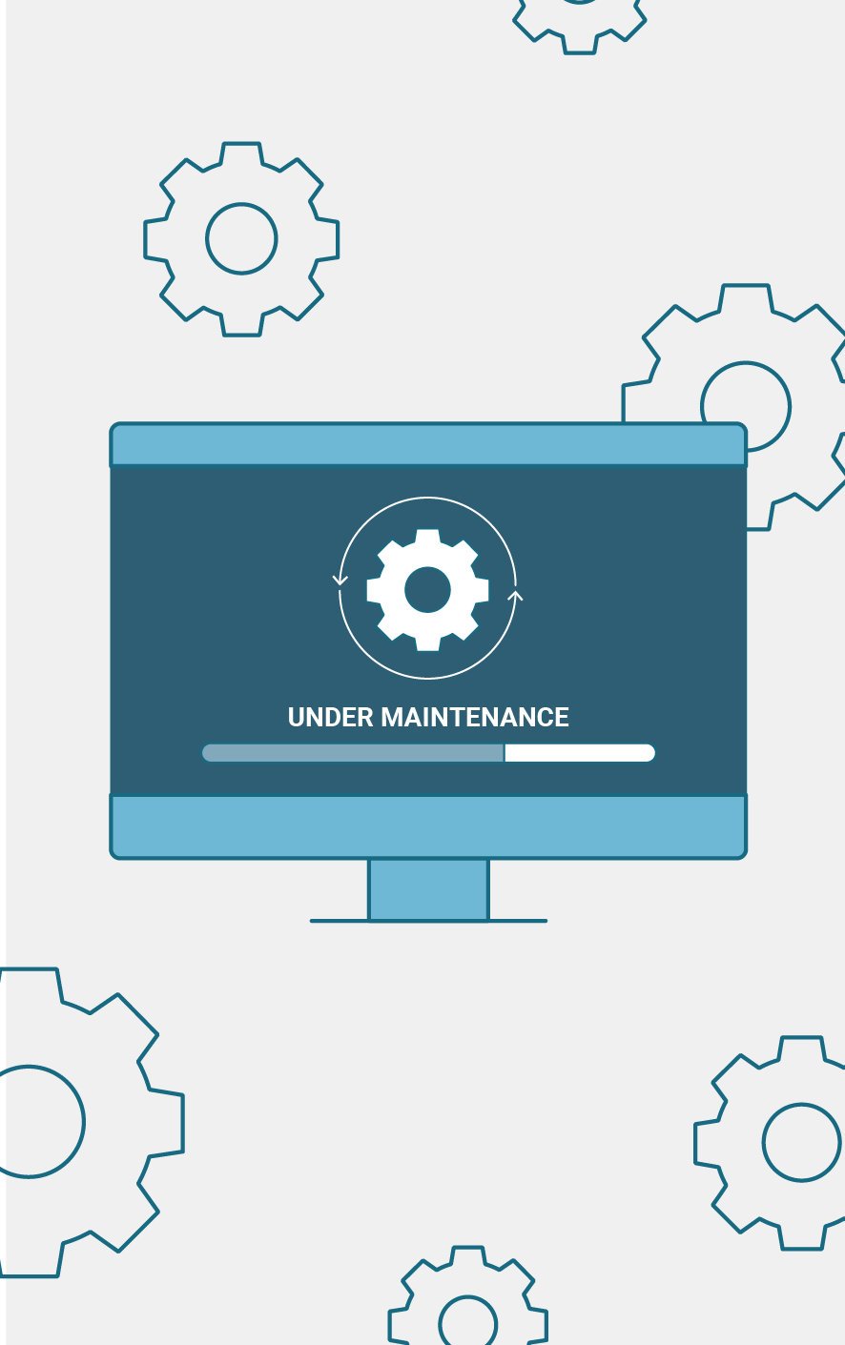
Linux Hardening
Hardening steps can include:
Assuring correct permissioning and system access.
Removing unnecessary services, processes, and applications.
Utilizing secure configuration options.
Patching and updating current systems and processes.

Slide 14

Day 1 Project Overview

Slide 15


Project Scenario
You will play the role of a security professional tasked with hardening a Linux server owned by the firm The Baker Street Corporation (BSC).
BSC has confidential data on their server, therefore they need you to confirm their system is properly configured to protect them from security breaches.
If you identify any security issues, they are also requesting that you make the necessary updates.
Notes:
shutterstock_1888488028

Slide 16
Project Documentation
You will be provided with two documents:
Guide
Hardening Summary
Assist with the steps for Day 1:
System inventory and backup
Auditing users and groups
Password policies
sudo permissions
File and directory permissions
Checklist document that you will be submitting as a deliverable at the end of your project.
Remember to update the checklist as you progress through each activity.

Slide 17


Day 1 Project Overview
Pre-hardening steps: System inventory and backup
Document details about
the operating system.
Create a backup.

Slide 18
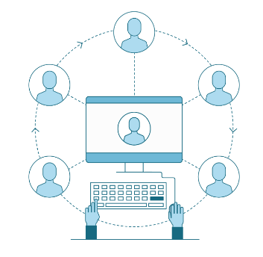
Day 1 Project Overview
Auditing users and groups
Ensure that only the correct
BSC employees and groups
have the minimal access
needed to do their jobs.
Check and update the security permissions of BSC employees and groups.

Slide 19
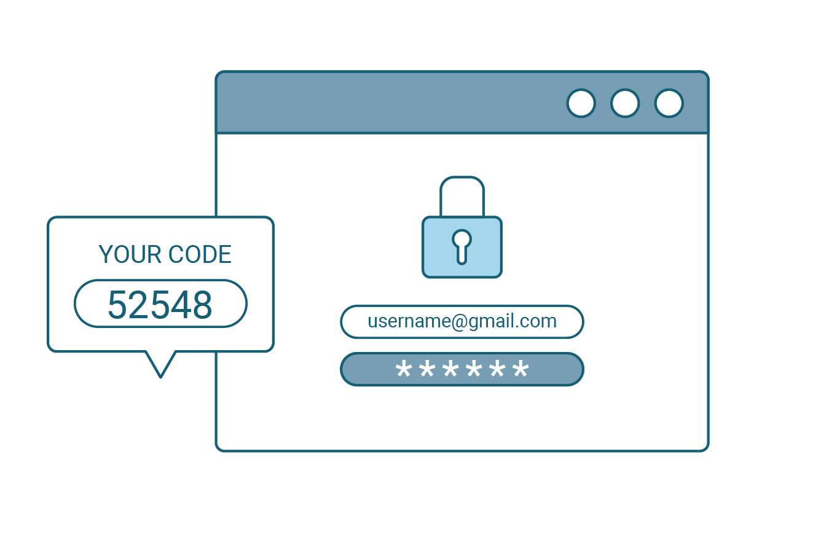
Day 1 Project Overview
Updating and enforcing password policies
Identify BSC employees with
weak passwords.
Create and implement strict password policies.
Force users to update passwords.

Slide 20

Day 1 Project Overview
Updating and enforcing sudo permissions
Validate and update the sudoers file.
Only grant sudo privileges for specific tasks.

Slide 21
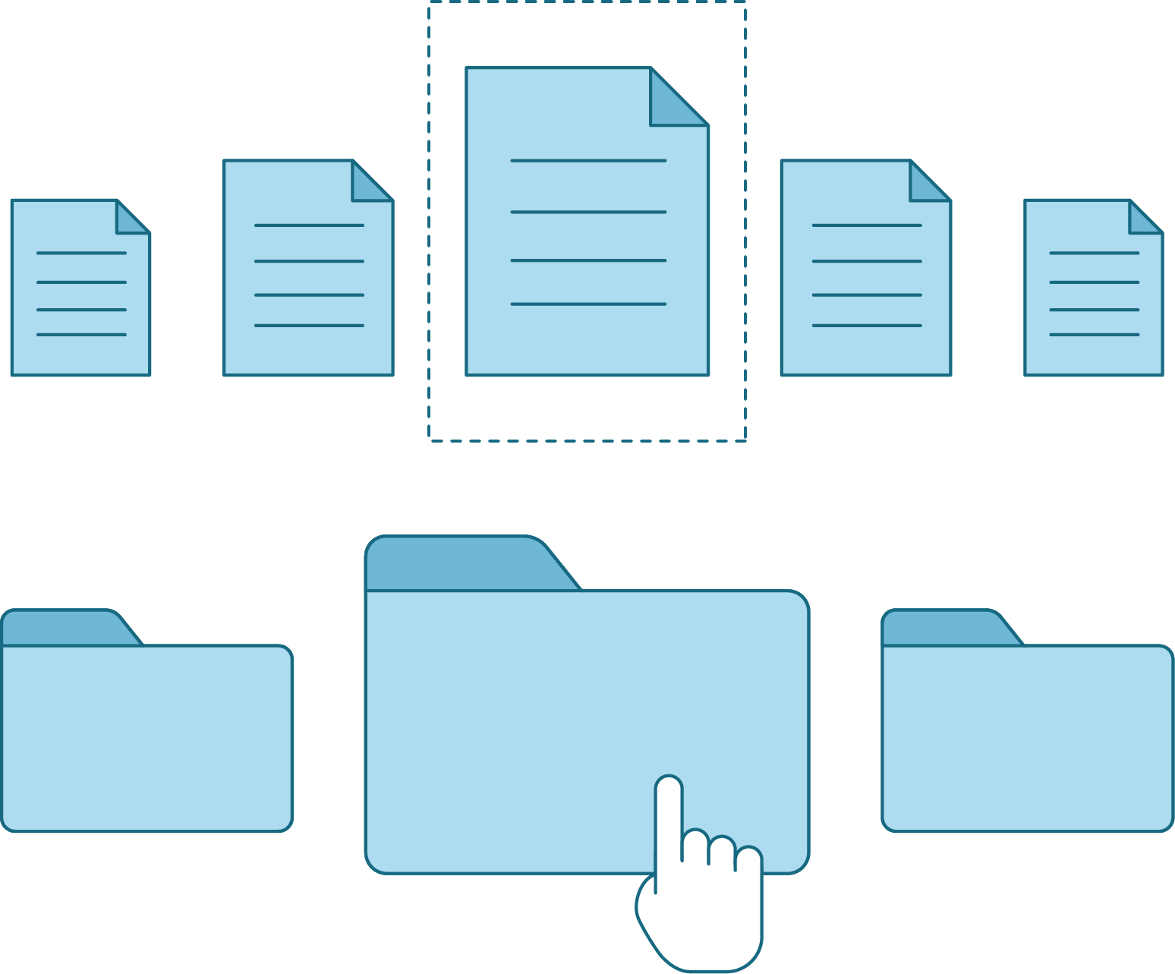
Day 1 Project Overview
Validating and updating permissions on files and directories
Check files and directories.
Fix any security issues you discover.

Slide 23
Hardening your Linux server
For the remainder of today's class, you will work on completing Day 1
project tasks.
While you are responsible for completing your own project, you can ask classmates, the TA, or the instructor to assist if you have any questions.
Remember to complete the checklist document as you progress through the activities.
Remainder of class

Slide 26
Day 2: Hardening your Linux server's system settings

